Slide 1
Point Cloud Denoising
Krister Ulvog

Slide 2
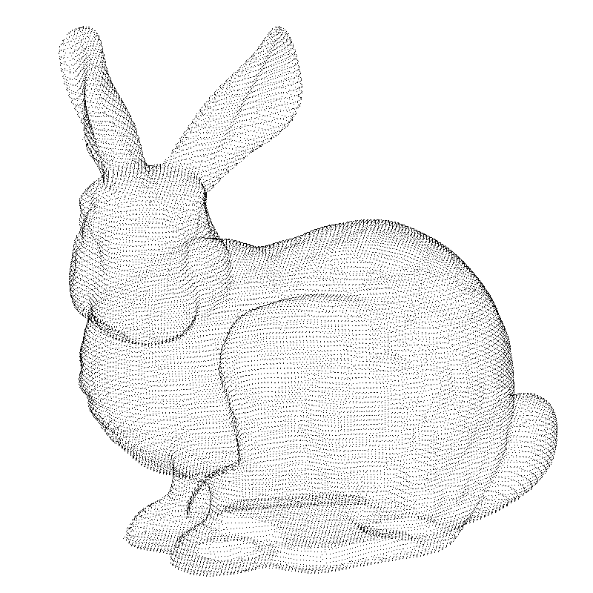
What is Point Cloud?
A point represents 3d coordinate

Slide 3
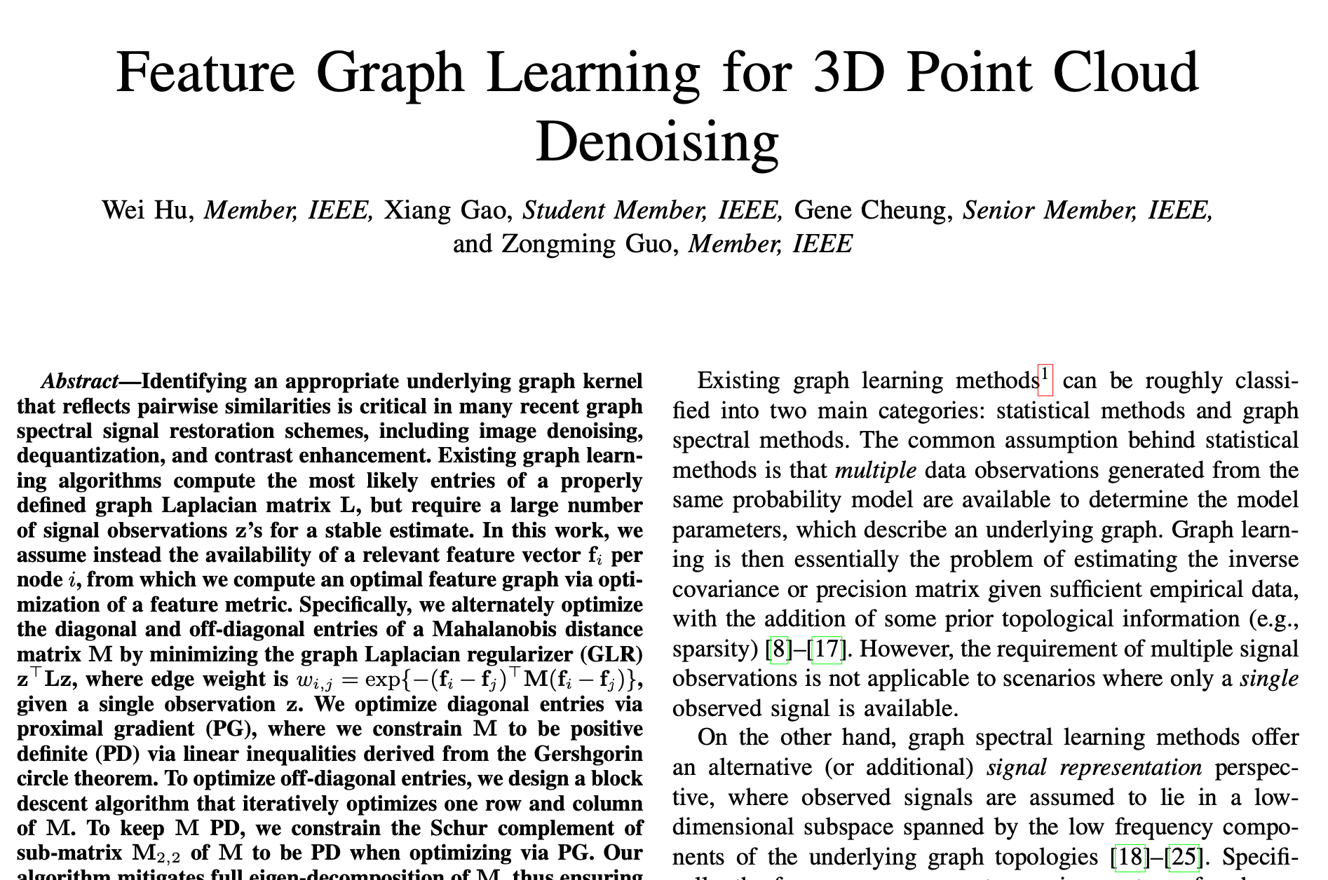
Outline
Point Cloud Denoising via Feature Graph Learning
My naïve algorithm

Slide 4
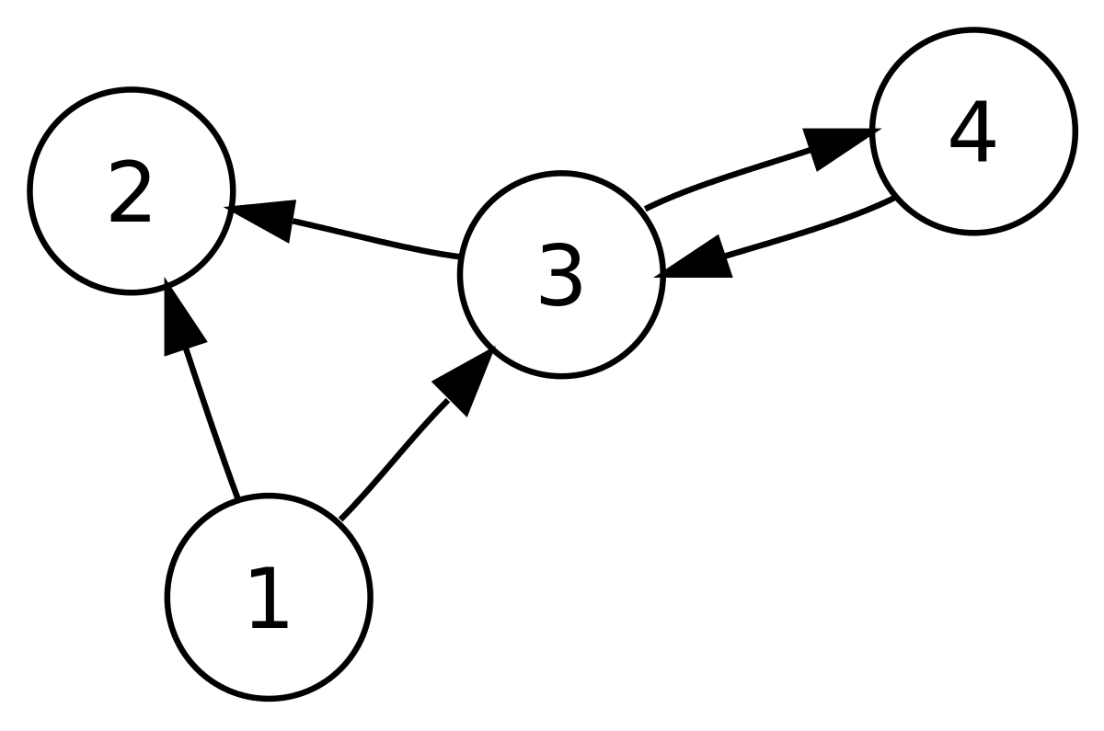
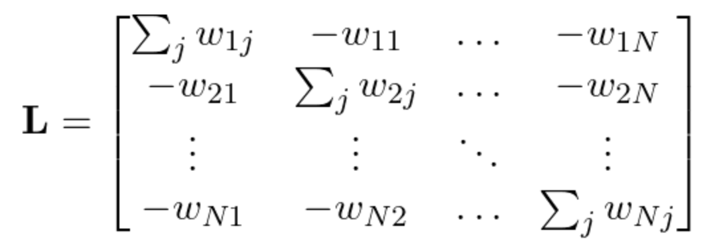
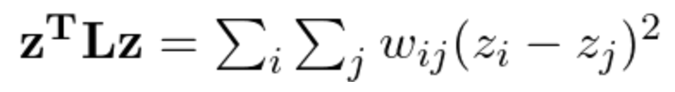
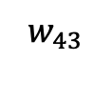
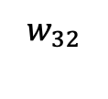
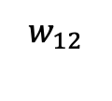
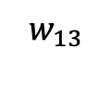
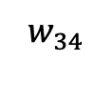
Laplacian Regularizer
$$w_{34}$$
$$w_{32}$$
$$w_{43}$$
$$w_{12}$$
$$w_{13}$$

Slide 5
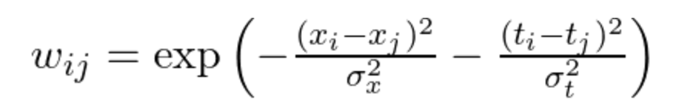
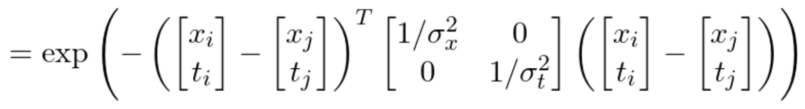
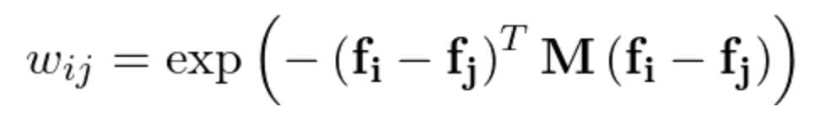


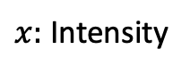
What should $w_{ij}$ look like?
Bilateral Filter Example
$x:$ Intensity
t$:$ location of pixel
General Form

Slide 6

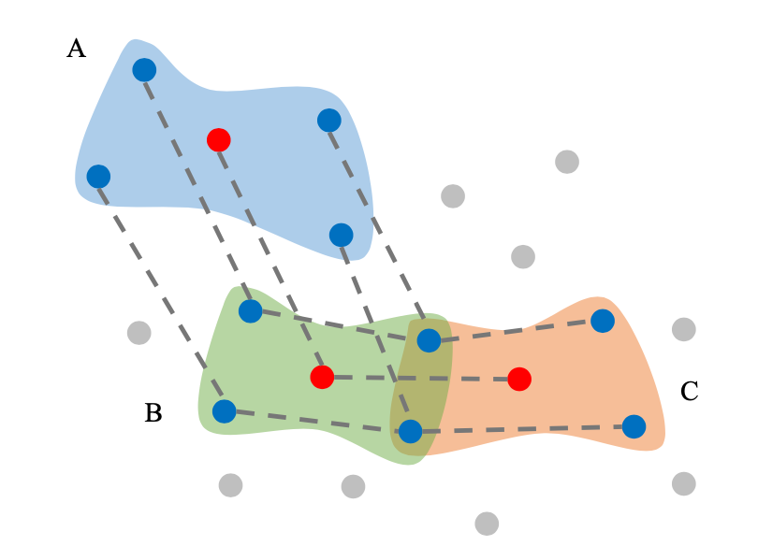
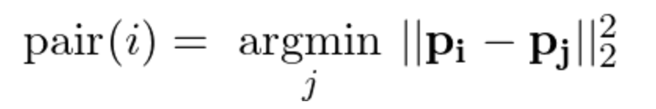
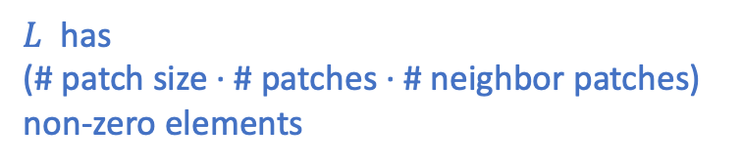
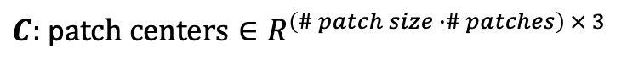
Denoise using Patch-based Regularizer
$S:$ sampling matrix ${∈R}^{\left(\# patch size ∙\# patches\right) × (\# points)}$
$L$ has
(# patch size · # patches · # neighbor patches)
non-zero elements
$C:$ p$atch centers{∈R}^{\left(\# patch size ∙\# patches\right) × 3}$
Overlapping patches
patch center
corresponding pair
For each patch
For each neighboring patch
Relative coordinate from a patch
Relative coordinate from a near patch

Slide 7
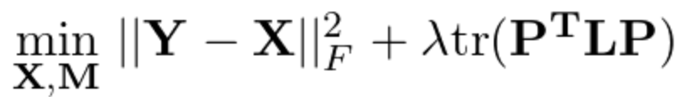
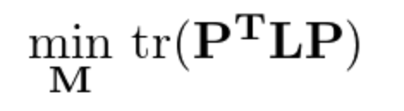
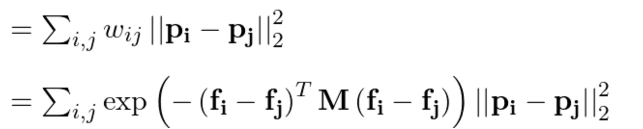
Optimizing M
Optimize diagonal and off-diagonal back and forth!

Slide 8
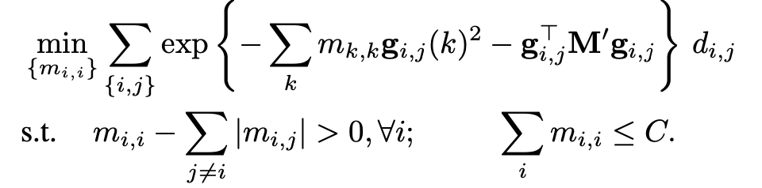
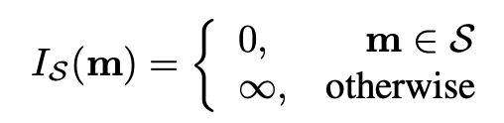
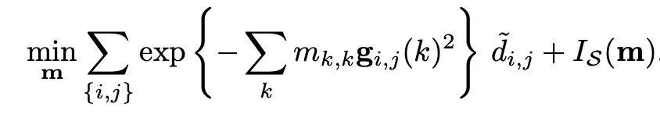
Diagonal M
Solve
Convex and
non-differentiable
Convex and differentiable
Use Proximal Gradient Descent!

Slide 9
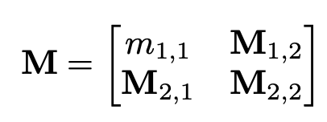
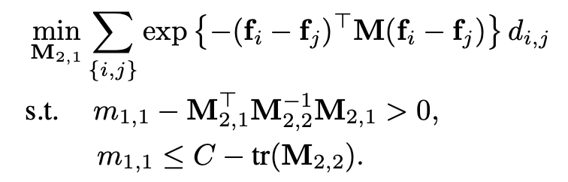
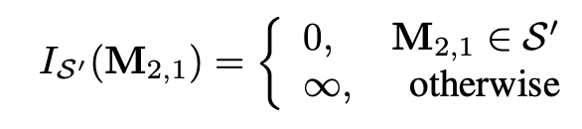
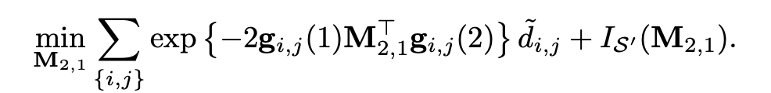
Off-diagonal M
Decompose the matrix into blocks and solve for M_{2,1}
Convex and
non-differentiable
Convex and differentiable
Use Proximal Gradient Descent and repeat for different columns!

Slide 10
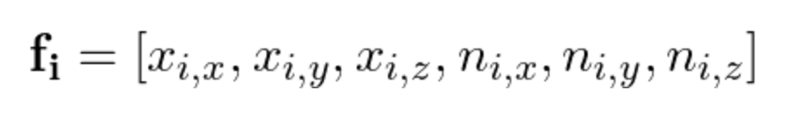
Optimize M
Iterate
Optimize off-diagonal
Block coordinate descent (for each column do proximal gradient descent)
Optimize diagonal
Proximal gradient descent
Coordinate
Normal

Slide 11
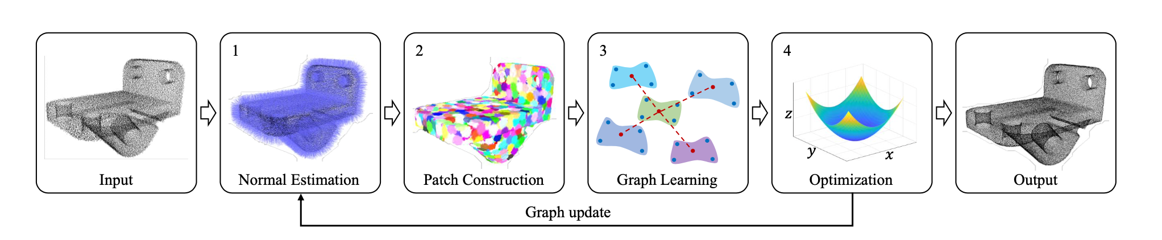
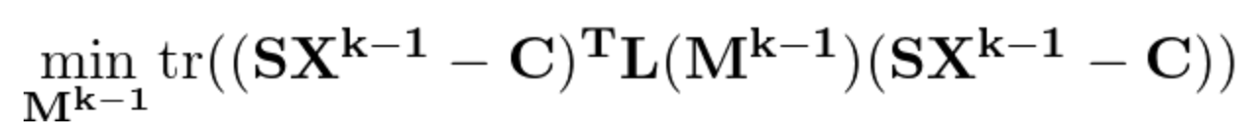
Full Algorithm
Iterate…
Compute normals
Construct patches S, C
Solve
Fix X and solve M
Fix M and solve X

Slide 12
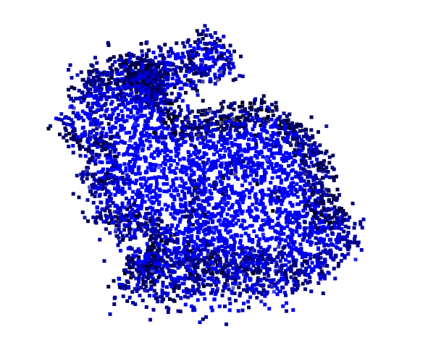
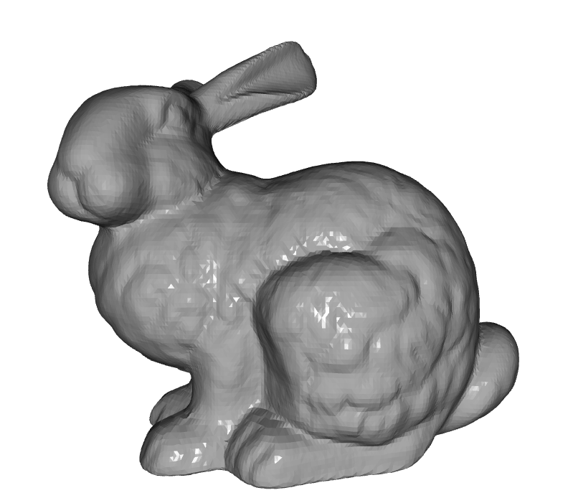
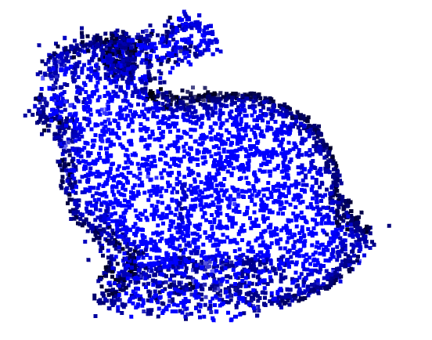
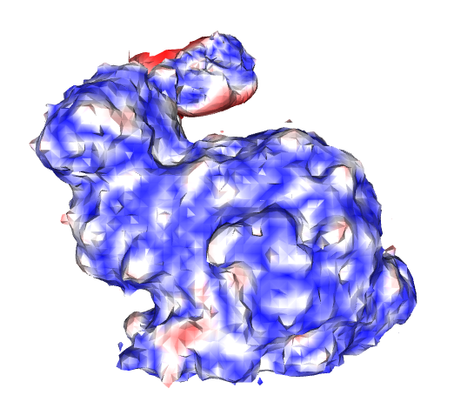
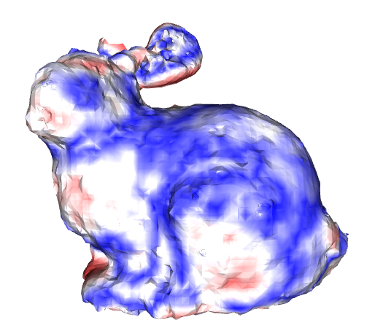
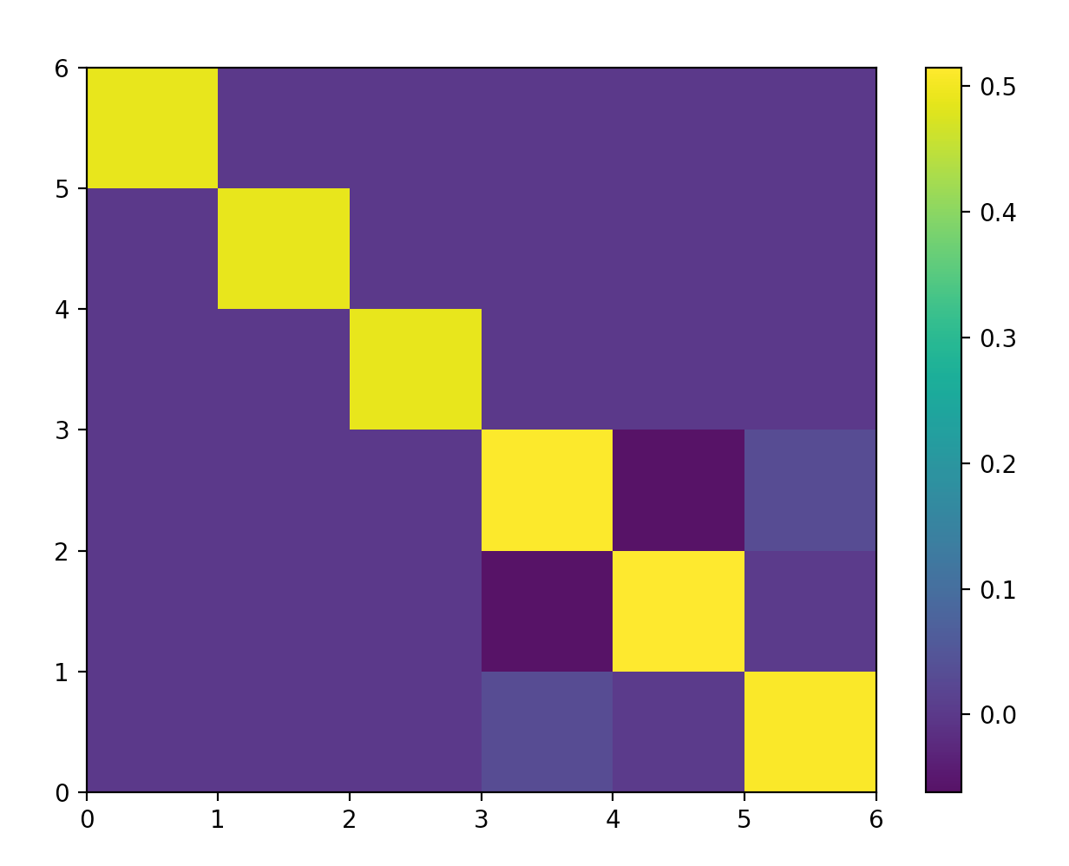
a) Ground Truth
b) Noisy: 3.840e-3
c) Denoised: 2.459e-3
d) Learned Metric
e) Noisy: 2.244e-3
f) Denoised: 2.408-3

Slide 13
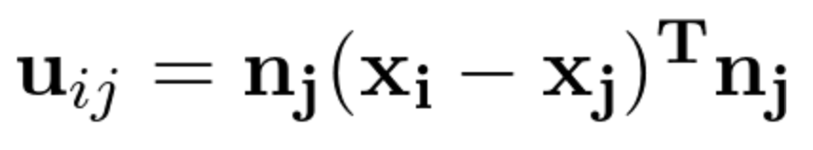
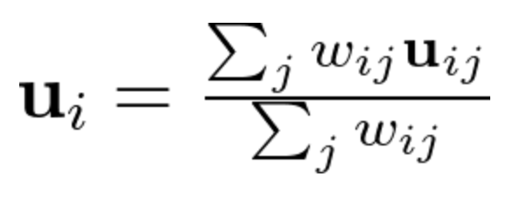
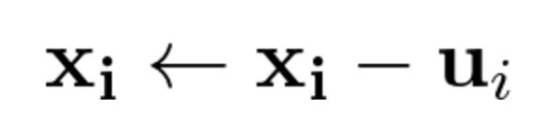
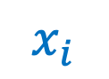
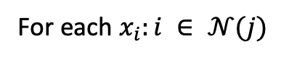
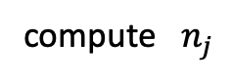
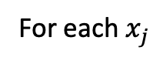

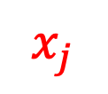
My Naïve Denoising Algorithm
If the surface is flat, then we want to project to plane perpendicular to normal
Iterate
For each $x_{j}$
compute $n_{j}$
Normal
For each $x_{i}:i ∈ 𝒩(j)$
$$x_{i}$$
$$x_{j}$$
compute $w_{ij}$
compute

Slide 14
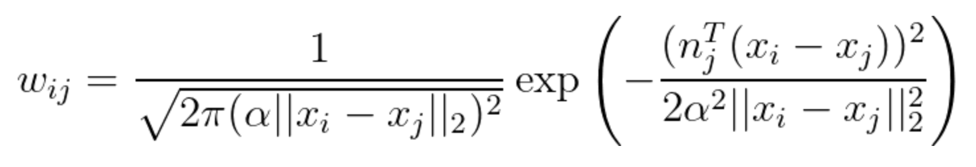
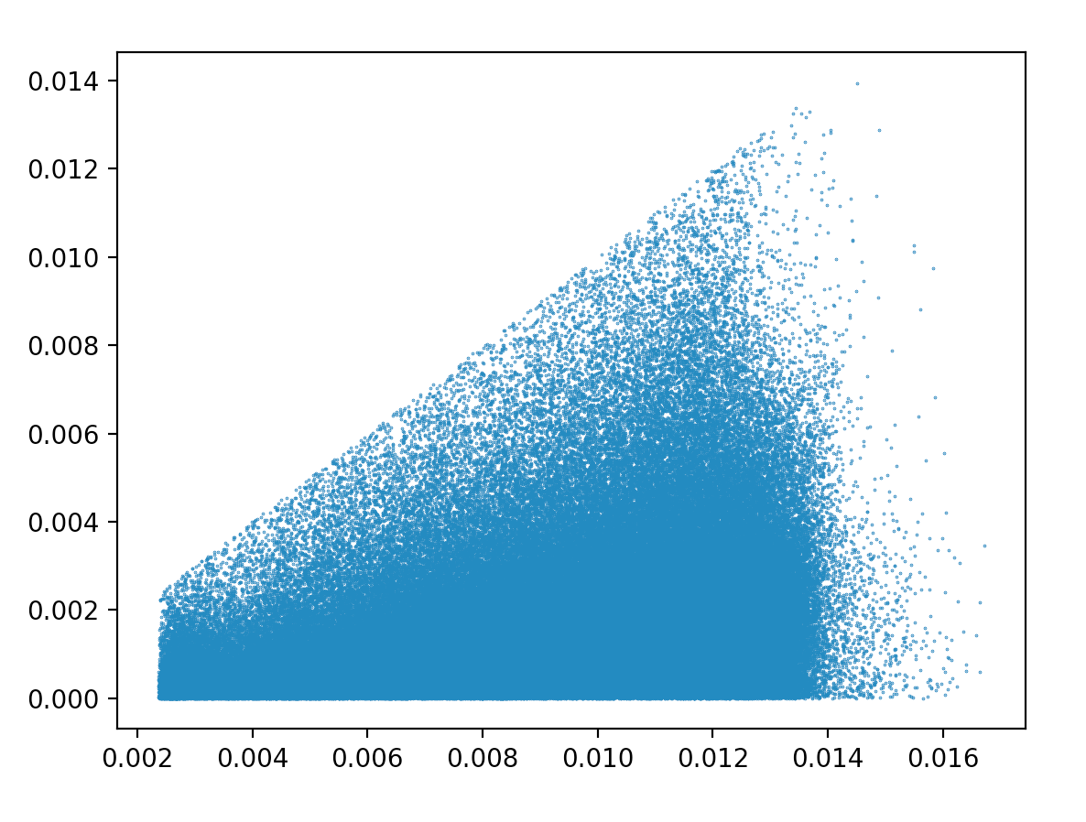
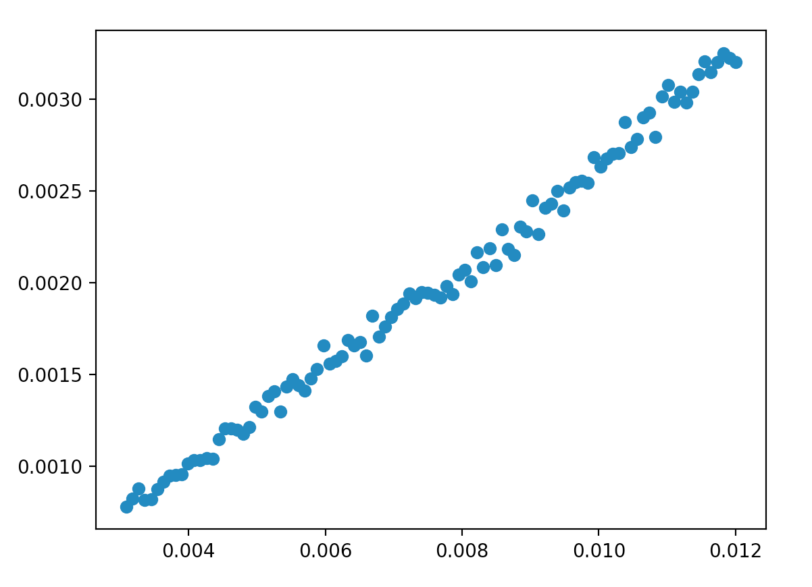
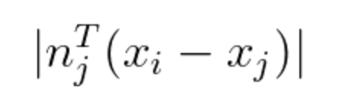
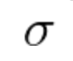



Weights computation
Normal
$$x_{i}$$
$$x_{j}$$

Slide 15



Iteration 1
Iteration 5
Iteration 10

Slide 16


How can we prevent oversmoothing?
At the end of every iteration
Iteration 10
We choose $λ$ to be exponentially decaying with iterations

Slide 17




a) Noisy: 3.78e-3
b) Denoised: 1.87e-3
c) Noisy: 2.29e-3
d) Denoised: 1.98e-3

Slide 18





Slide 19




a) Noisy: 1.920e-1
b) Denoised: 1.915e-1
c) Noisy: 2.244e-3
d) Denoised: 1.804e-1

Slide 20






a) Ground Truth
b) Noisy: 1.921e-1
c) Denoised: 1.920e-1
d) Learned Metric
e) Noisy: 1.864e-1
f) Denoised: 1.857e-1

